Slide 1
Atmel AVR ARCHITECTURE AND INSTRUCTION SET
EE4144 Intro to Embedded Systems

Slide 2
MAIN FEATURES
16-bit instructions
8-bit registers
Most executed in single cycle
Most can be conditionally executed
Load/store

Slide 3
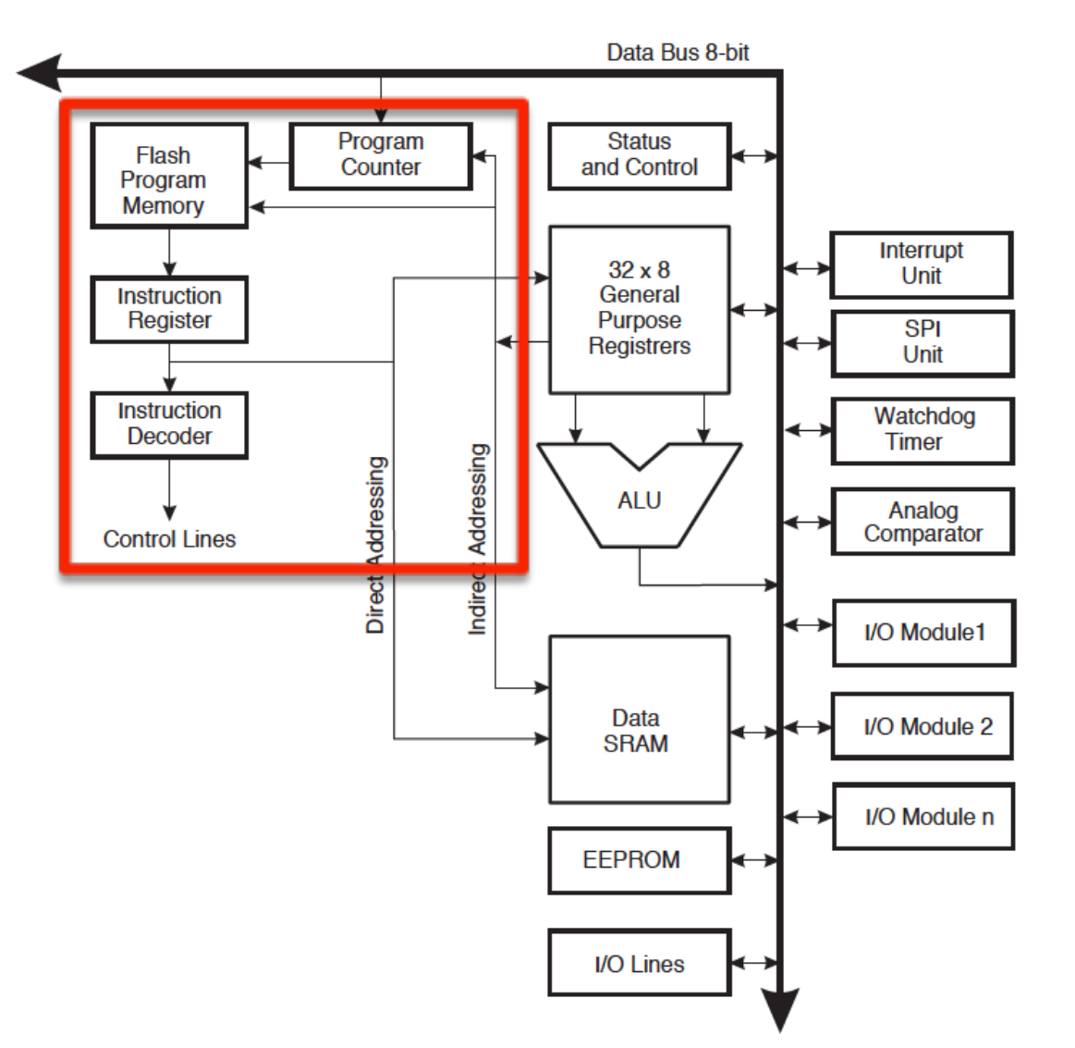
AVR Instruction Fetch/Decode

Slide 4
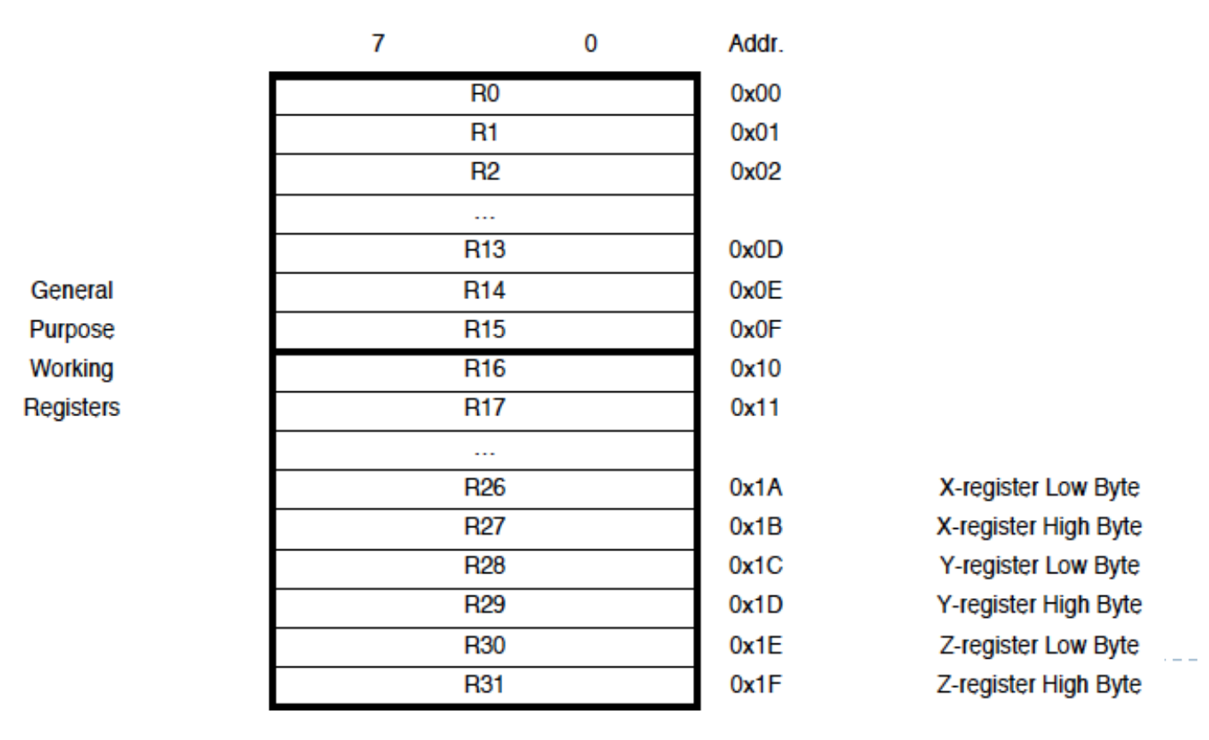
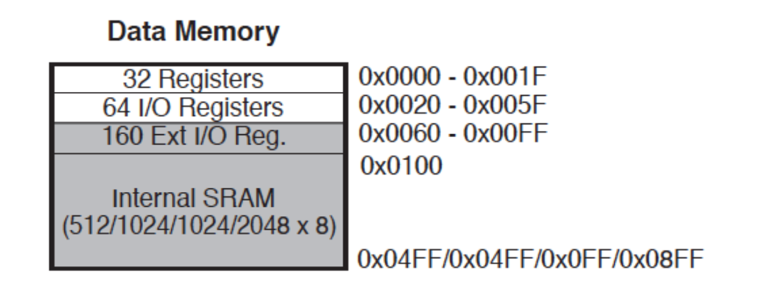
Register Structure
32 x 8 General Purpose Registers (GPRs)
Part of SRAM Memory Space

Slide 5
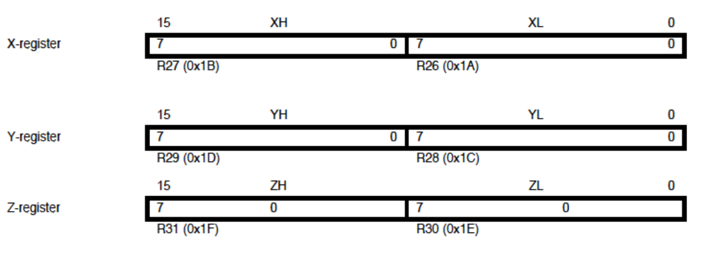
Special Registers
Making 16 bit registers out of 2 8 bit registers
X,Y, and Z from R26-R31 (with Indirect Addressing mode)

Slide 6
Addressing Modes
Indirect addressing means that the address of the data is held in an intermediate location so that the address is first 'looked up' and then used to locate the data itself.
Direct addressing mode means that the value for a given instruction in assembly programming is pointed to by a given value. This means the value is variable, based on what is stored in memory at a given address. The instruction encoding itself contains the address of the location.

Slide 7
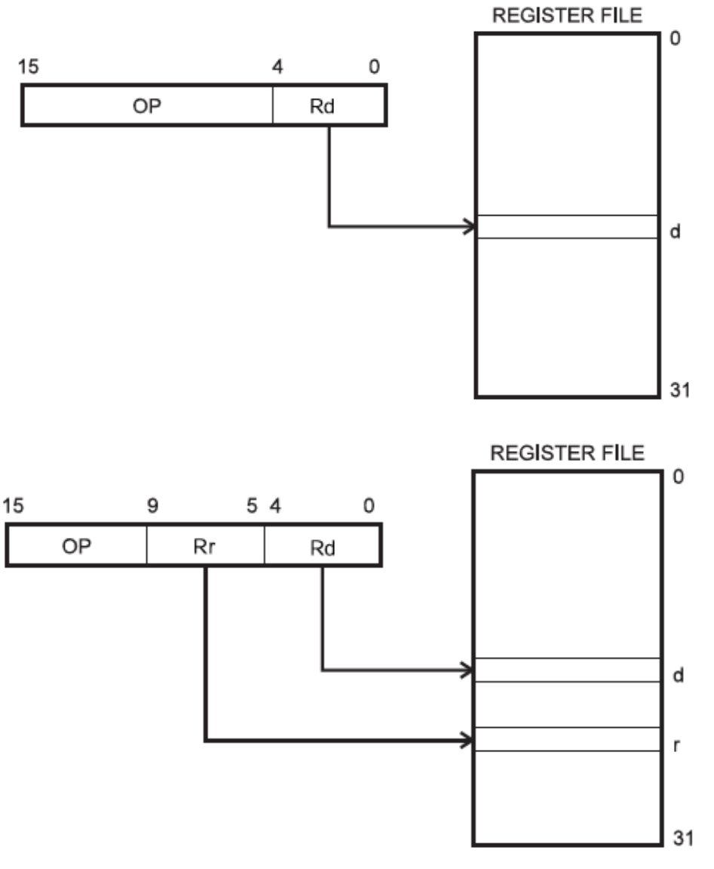
Addressing Modes
Direct Register Addressing:

Slide 8
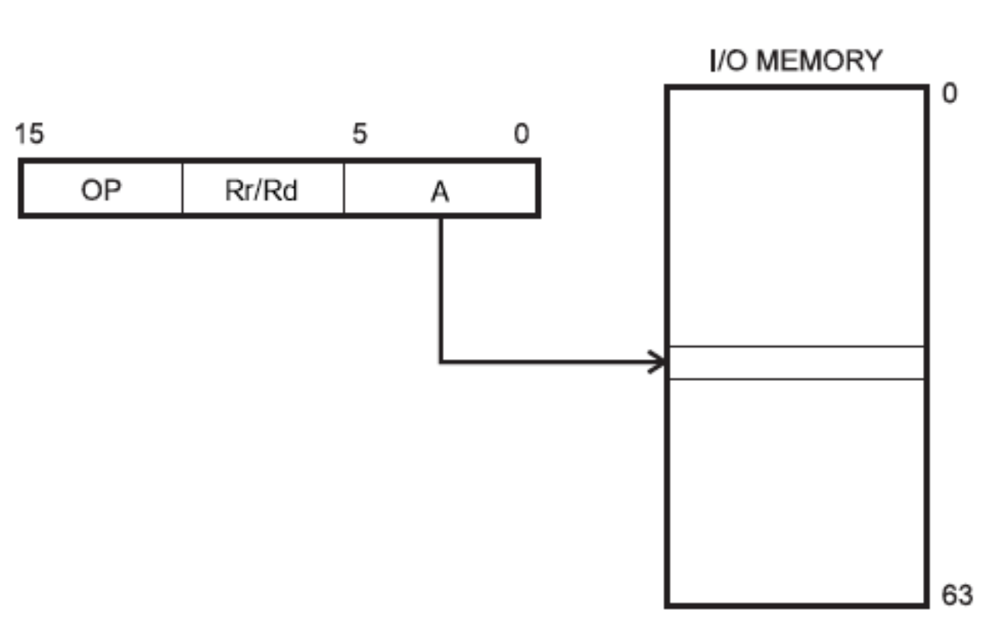
Addressing Modes
Direct I/O Addressing:

Slide 9
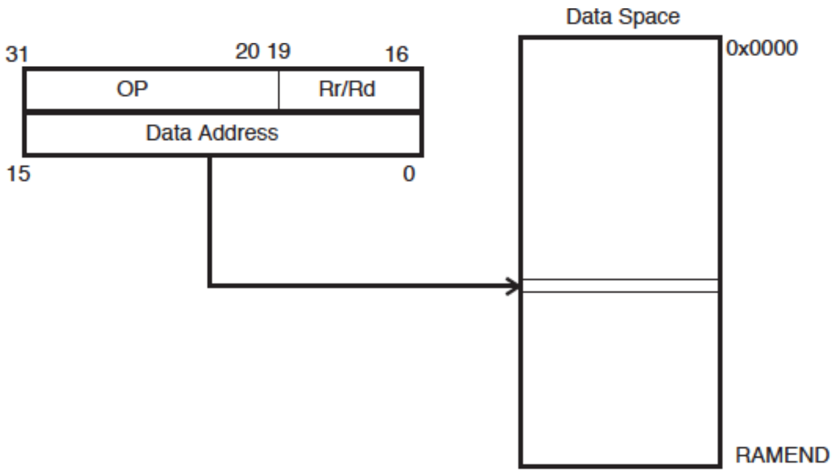
Addressing Modes
Direct Data Memory Addressing:

Slide 10
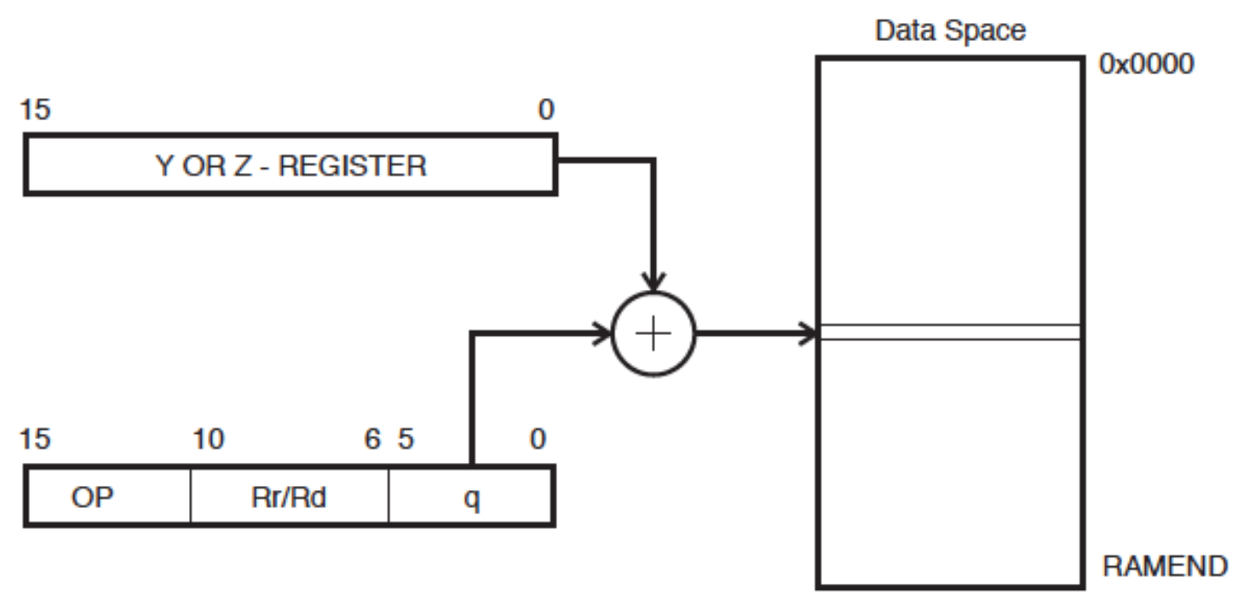
Addressing Modes
Direct Data Memory Addressing (w/th and without displacement):

Slide 11
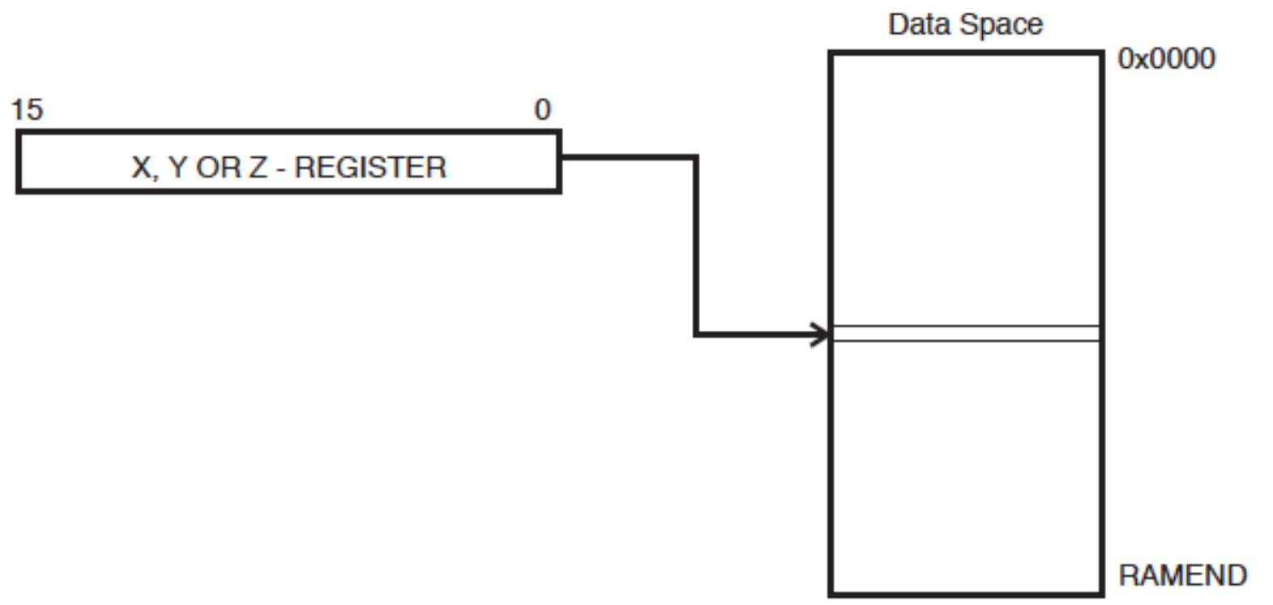
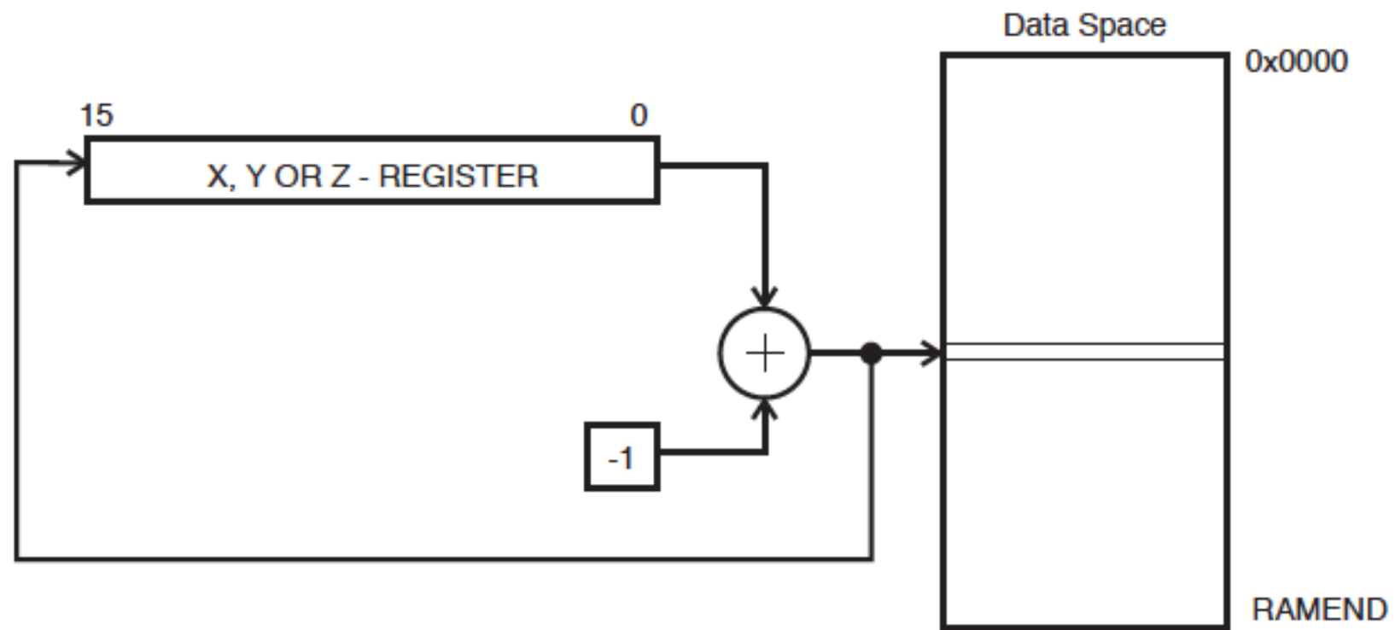
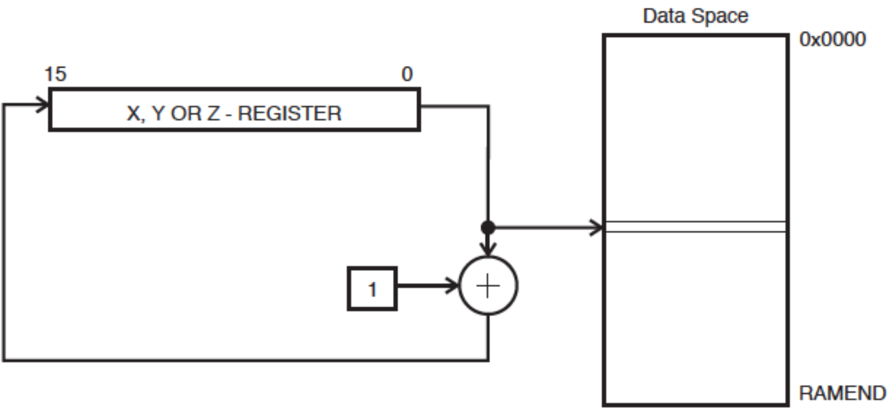
Addressing Modes
Indirect Data Memory Addressing:
Pre-decrement:
Post Increment:

Slide 12
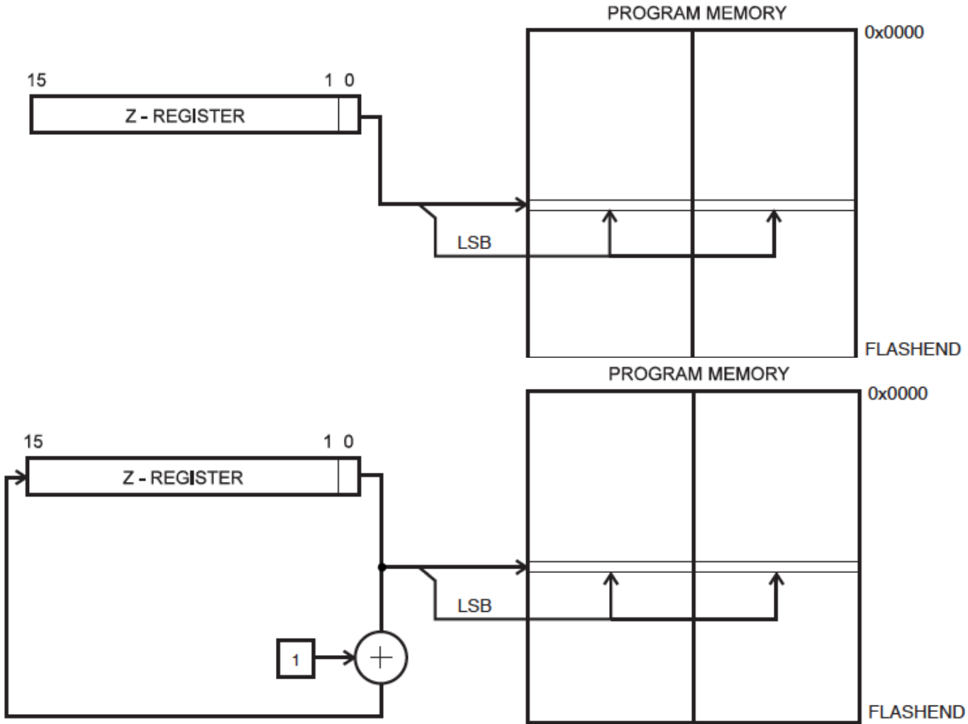
Addressing Modes
Program Memory Addressing:

Slide 13
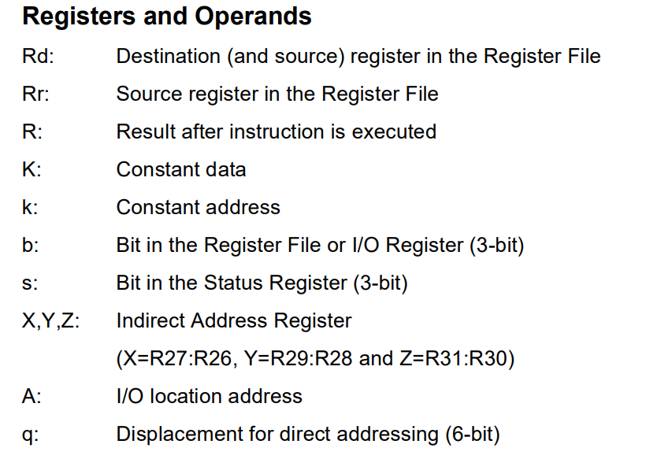
Anatomy of an Assembly Instruction
INSTRUCTION Operand1, Operand2

Slide 14
COMMON OPERATIONS
Load and store instructions: LDR, STR, etc.
Move instructions: MOV, etc.
Branch (jump) instructions: B, BL, BX, BLX, etc.
Stack push and pop instructions: PUSH, POP, etc.
Arithmetic operations: ADD, SUB, MUL, SDIV, UDIV, etc.
No operation (null operation): NOP

Slide 15
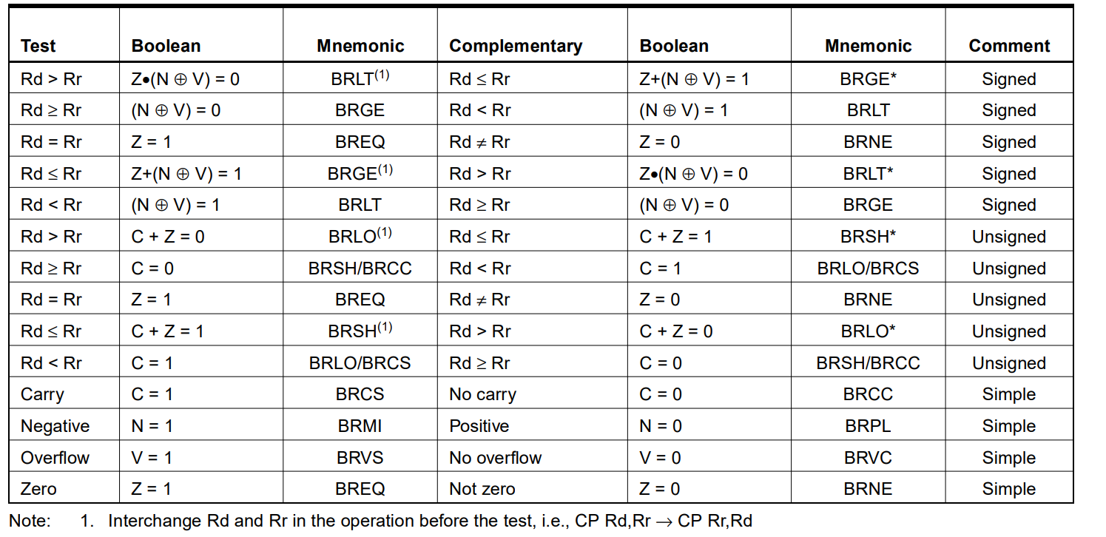
Conditional Branch Summary

Slide 16
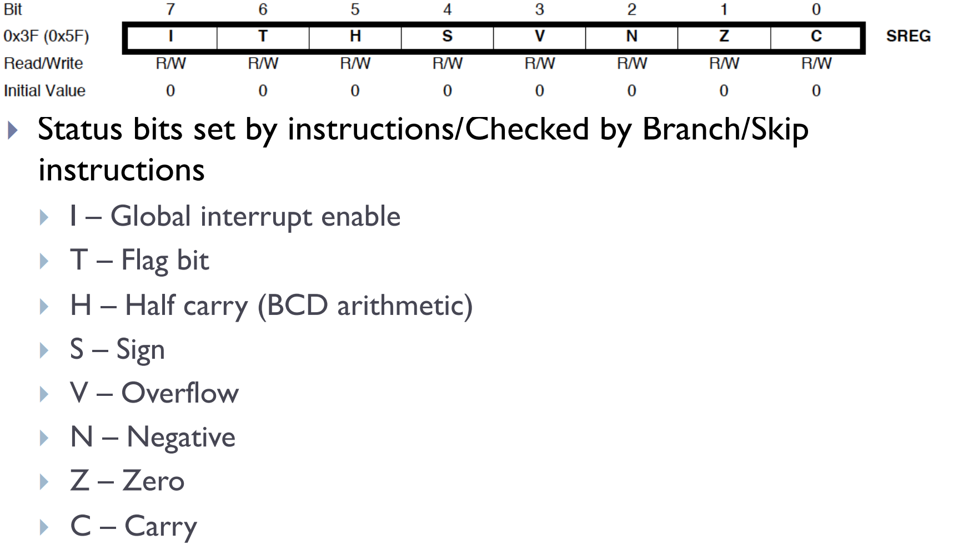
Status Register

Slide 17
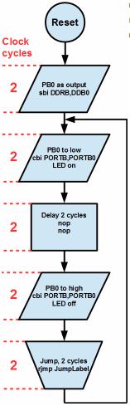
Flow Control (A Simple Blink)

Slide 18
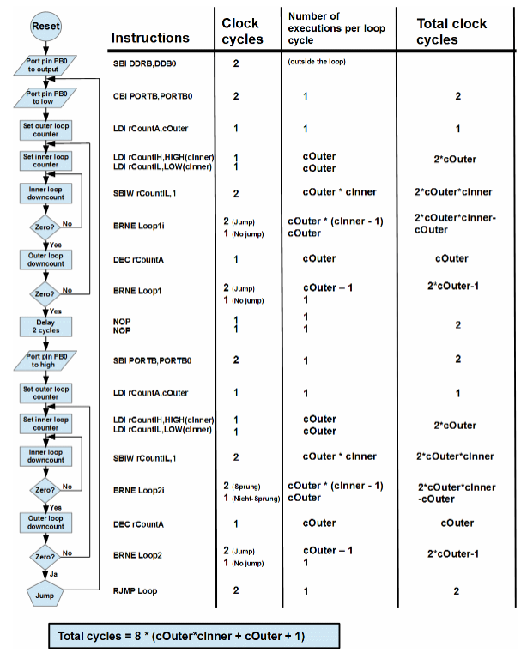
Flow Control (A Complicated Blink)

Slide 19
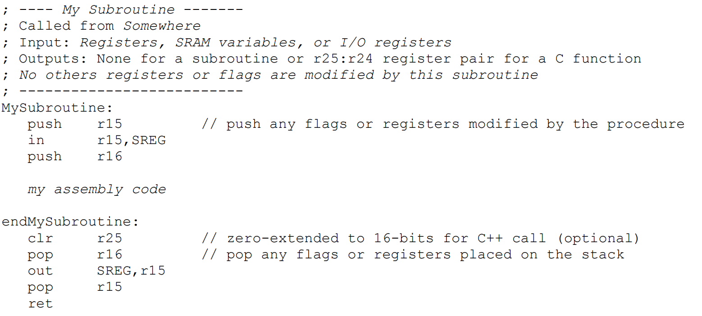
A Subroutine Template

Slide 20
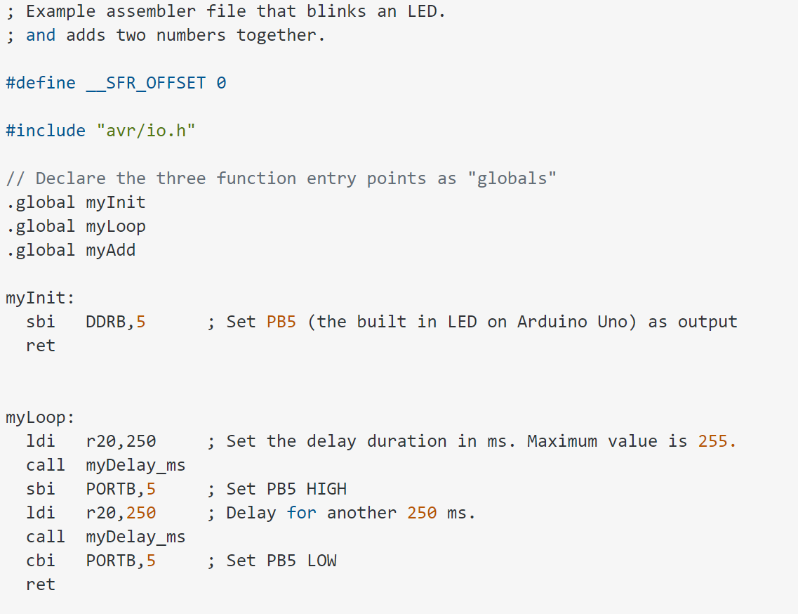
A Subroutine Template

Slide 21
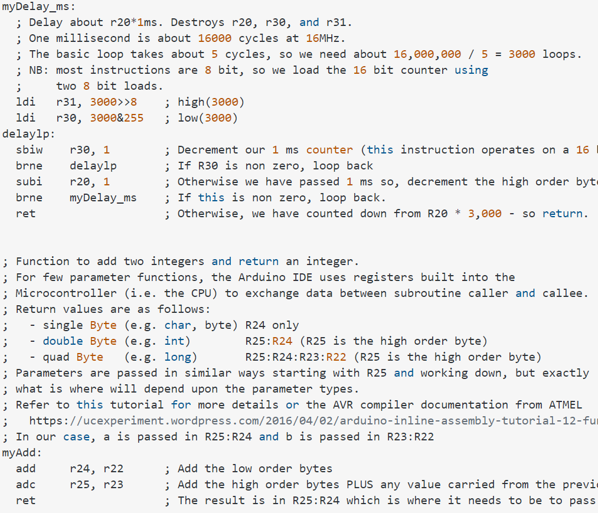
A Subroutine Template

Slide 22
A SIMPLE C PROGRAM
int total;
int i;
total = 0;
for (i = 10; i > 0; i--) {
total += i;
}

Slide 23
ASSEMBLY EQUIVALENT
LDI R0, #0 ; R0 accumulates total
LDI R1, #10 ; R1 counts from 10 to 1
again ADD R0, R1
SUBI R1, #1
BRNE again
Done: JMP Done ;infinite loop to stop

Slide 24
Calling Conventions
Registers:
r0 : Temporary register - use in interrupts not recommended.
r1: Zero register - can be used for temporary data but must be zero'd after use.
r18-r27, r30-r31: These are general purpose registers and don't need to be saved when using in conjuction with 'C' code.
r2-r17, r28-r29 These are general purpose registers but do need to be saved when using in conjuction with 'C' code.

Slide 25
Calling Conventions
Passing Parameters:
Registers R25 through R8 - in that order !
; Define Assembly Directives
.DEF parm1H = r25
.DEF parm1L = r24
.DEF parm2H = r23
.DEF parm2L = r22
.DEF parm3H = r21
.DEF parm3L = r20
Returning Values
R24 8 bit values
R25-R24 16 bit values
R25-R22 32 bit values
R25-R18 64 bit values

